Slide 1

Cloud Computing Service Models
IaaS, PaaS, SaaS

Slide 2
Cloud Service Models
A cloud service model defines how cloud computing resources are provided to users over the internet.
These models determine the level of control and responsibility the user has over the infrastructure, platform, and software.

Slide 3
Infrastructure as a Service (IaaS)
IaaS is the basic level of cloud computing where you rent core IT resources such as:
  Virtual Machines (servers)
  Storage
  Networking
You manage what runs on those resources (like the OS, apps, and data), but not the physical hardware.

Slide 4
How It Works
You rent computing power (like virtual servers).
You choose how to install, configure, and manage your software.
You pay only for what you use.
You are responsible for:
  Operating systems
  Software updates
  App deployment
  Data backup

Slide 5
Why Use IaaS?
Scalable Easily add more servers or increase capacity.
Cost-Effective No need to buy physical hardware.
Customizable Full control over your software setup.
Fast Deployment Get infrastructure ready quickly for development/testing.

Slide 6
Example Scenario
A startup building a web app rents virtual servers using IaaS.
They install the OS, set up the database, and deploy their app.
As the app grows, they scale up by renting more servers — no hardware needed!

Slide 7
Simple Analogy: Renting an Empty Kitchen
IaaS is like renting an empty kitchen:
You get the kitchen space, stove, fridge, and electricity.
You bring your own ingredients, recipes, and cooking tools.
You cook the food, serve it, and clean up afterward.
You pay rent for the kitchen space, not the cooking service.
Just like IaaS, you get the infrastructure, but you manage everything on top of it — like software, data, and settings.

Slide 8
What is PaaS?
PaaS is a cloud computing model where the provider gives you a ready-made platform to build and run your applications.
You don’t manage the servers, operating system, or hardware.
You only focus on writing and deploying your app code.

Slide 9
How It Works
The cloud provider handles:
Servers
Operating system
Networking
Security patches
You manage:
Your application code
Configuration
Data

Slide 10
Why Use PaaS
Faster Development – Focus only on building your app, not managing infrastructure.
No Server Management – Provider handles all backend operations.
Easy to Scale – Automatically adjusts based on usage.
Cost-efficient – Pay for resources you use, not for managing full systems.

Slide 11
Example Scenario
A developer wants to create a mobile app.
With PaaS, they can:
Use built-in tools for coding, testing, and deploying.
Store user data in a cloud database.
Ignore server setup, updates, or OS management.
They launch the app faster and scale it as needed — without worrying about backend tasks.

Slide 12
Simple Analogy: Renting a Ready-to-Use Kitchen
PaaS is like renting a fully equipped kitchen in a cooking studio:
The studio provides the stove, utensils, and cleaning.
You bring your ingredients and cook your meal.
You don’t need to fix the oven or clean the chimney.
You focus only on making the dish, not managing the kitchen.
Just like in PaaS, you focus on your app, while the provider handles everything else behind the scenes.

Slide 13

What is SaaS?
SaaS is a cloud model where you use fully ready-made software over the internet.
No need to install, manage, or update anything.
Everything — from servers to the app itself — is managed by the provider.
You just log in and start using the software

Slide 14
How It Works
The cloud provider manages:
Servers
Operating system
Application
Security and updates
You are simply:
Use the app
Enter data
Perform tasks via a browser or app

Slide 15
Why Use SaaS
Easy Access – Use from any device with internet.
No Setup Needed – Just sign up and start.
Automatic Updates – Always the latest version.
Budget Friendly – Subscription-based (monthly/yearly).

Slide 16
Example Scenario
A company uses an online email and document tool (like Gmail or Google Docs).
They:
Access the app via browser
Don’t install or maintain any software
Share files and communicate easily
Get updates automatically
This is SaaS — ready-to-use software over the internet.

Slide 17
Simple Analogy: Dining at a Restaurant
SaaS is like eating at a restaurant:
You order a meal and enjoy it.
The restaurant handles cooking, serving, and cleaning.
You don’t worry about buying ingredients or washing dishes.
You just pay and eat.
Just like SaaS, you use the service without managing anything behind the scenes.

Slide 18
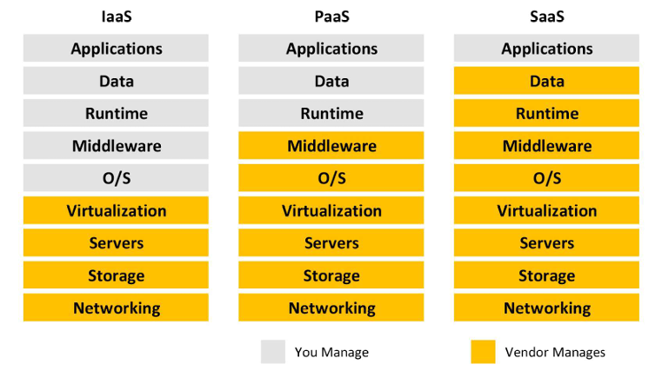
Shared Responsibility Model

Slide 19
COST AND OWNERSHIP
Category | IaaS | PaaS | SaaS
Upfront Costs | No upfront costs. Pay for what is consumed. | No upfront costs. Pay for what is consumed. | No upfront costs. Pay via subscription (monthly/yearly).
User Ownership | Responsible for software, OS, middleware, and app installation/config. | Responsible for app development and data. Not responsible for infra. | Only responsible for using the app and managing their data.
Cloud Provider Ownership | Provides and manages infrastructure (VMs, storage, networking). | Manages infra, OS, network, and platform. Provides managed environment. | Manages everything: infra, platform, and application software.

